Slide 1
Vision Transformer(VIT)
발표자: 문경환

Slide 2
Index
What is Transformer?
About VIT
Attention
Self-Supervision
Hyperparameters
Q&A

Slide 3
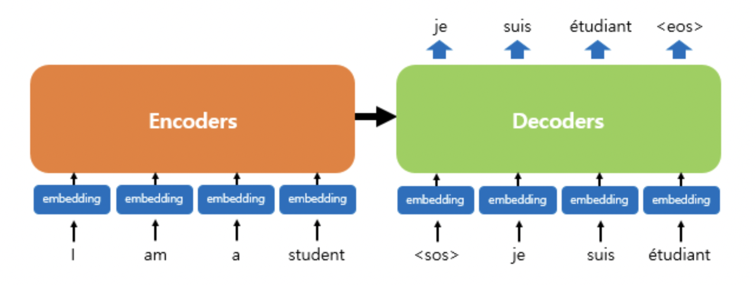
What is Transformer

Slide 4
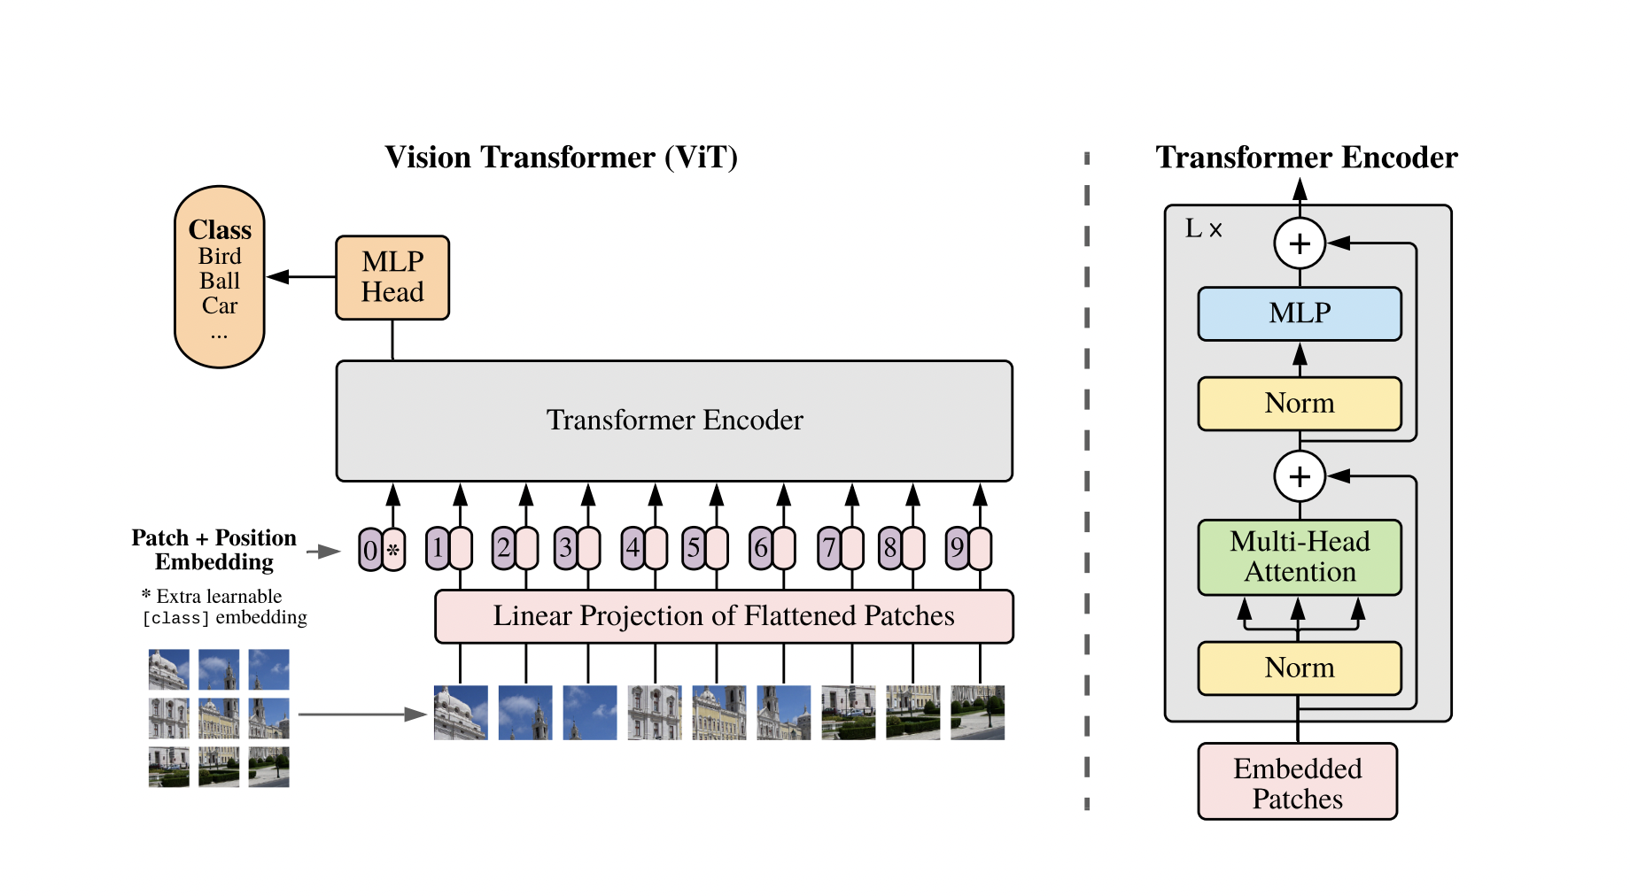
About VIT

Slide 5



About VIT
H : Height
W : Width
C : Channel
N : Resulting numbers of patches
(P, P) : Resolution of image
C : Channel
H : Hieight
W : Width
(P, P) : Resolution of image

Slide 6
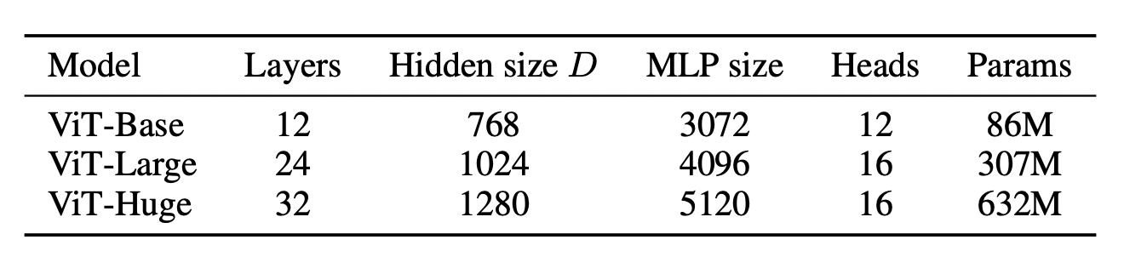
About VIT

Slide 7
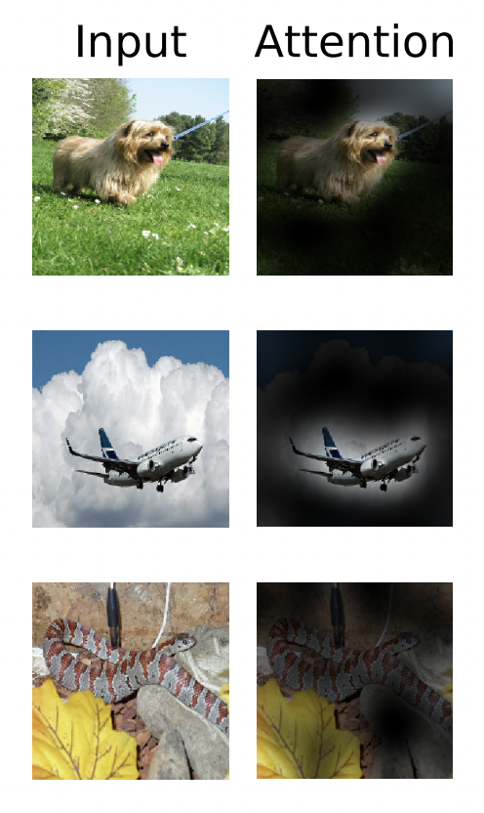
Attention
A learned Position embedding is added to the patch representation.
Closer patches tend to have more simmilar position embeddings.
Patches in the same row/column have simmilar embeddings.
This allows VIT to integrate information across the entire image even in the lowest layers

Slide 8
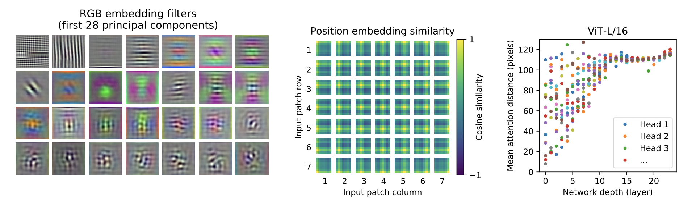
Self-Supervision

Slide 9
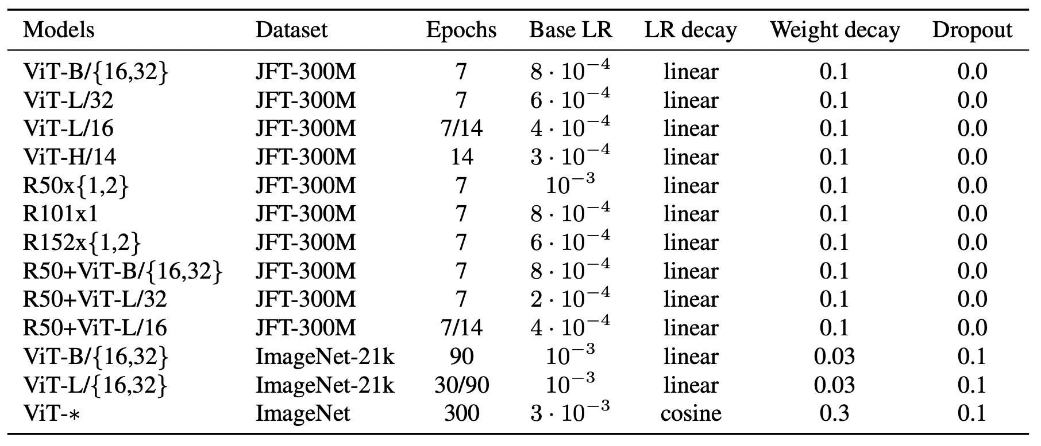
Hyperparameters

Slide 10
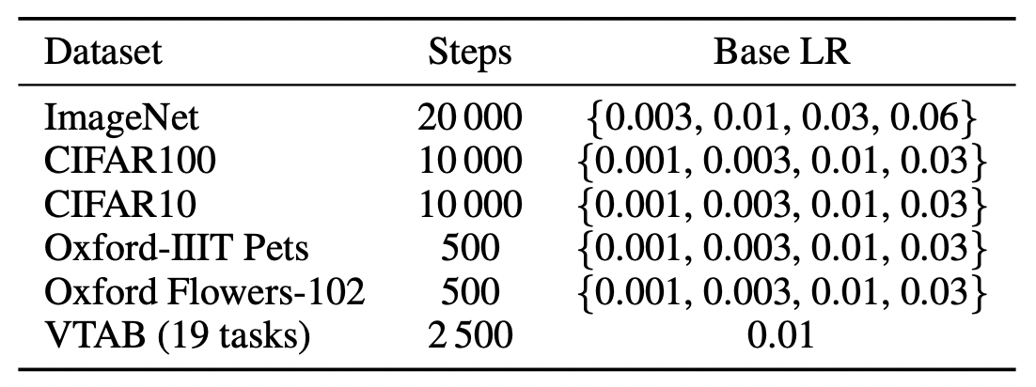
Hyperparameters

Slide 11
Q&A

